Slide 1
Capstone Project: The Battle of the Neighborhood
Finding a Better Place in North York, Toronto

Slide 2
Introduction:
The purpose of this Capstone Project is to help people in exploring better facilities around their neighborhood. It will help people making smart and efficient decision on selecting great neighborhood out of numbers of other neighborhoods in North York, Toronto.
Lots of people are migrating to various states of Canada and needed lots of research for good housing prices and reputed schools for their children. This project is for those people who are looking for better neighborhoods. For ease of accessing to Cafe, School, Super market, medical shops, grocery shops, mall, theatre, hospital, like minded people, etc.
This Capstone Project aim to create an analysis of features for a people migrating to North York to search a best neighborhood as a comparative analysis between neighborhoods. The features include median housing price and better school according to ratings, crime rates of that particular area, road connectivity, weather conditions, good management for emergency, water resources both fresh and waste water and excrement conveyed in sewers and recreational facilities.
It will help people to get awareness of the area and neighborhood before moving to a new city, state, country or place for their work or to start a new fresh life.

Slide 3
Data Section
Data Link: https://en.wikipedia.org/wiki/List_of_postal_codes_of_Canada:_M
We will need data about different venues in different neighborhoods of that specific borough. In order to gain that information we will use “Foursquare” locational information. Foursquare is a location data provider with information about all manner of venues and events within an area of interest. Such information includes venue names, locations, menus and even photos. As such, the foursquare location platform will be used as the sole data source since all the stated required information can be obtained through the API.
After finding the list of neighborhoods, we then connect to the Foursquare API to gather information about venues inside each and every neighborhood. For each neighborhood, we have chosen the radius to be 100 meter.

Slide 4
Data Section (Contd)
The data retrieved from Foursquare contained information of venues within a specified distance of the longitude and latitude of the postcodes. The information obtained per venue as follows:
Neighbourhood
Neighbourhood Latitude
Neighbourhood Longitude
Venue
Name of the Venue
Venue Latitude
Venue Longitude
Venue Category

Slide 5
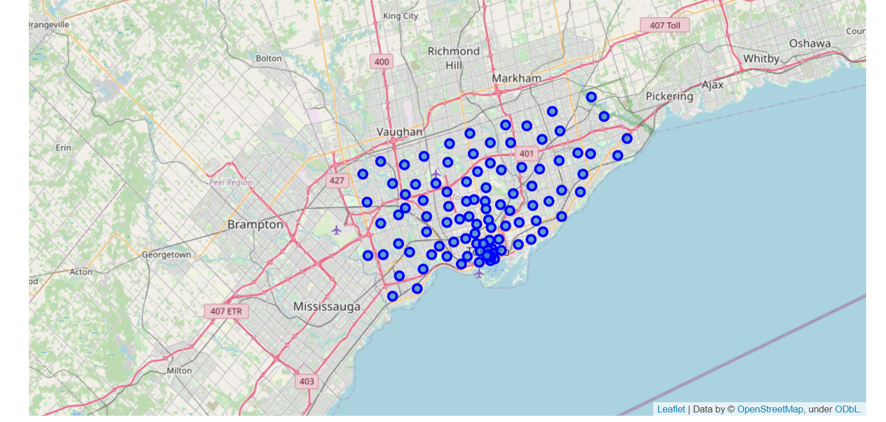
Map

Slide 6
Methodology Section
To compare the similarities of two cities, we decided to explore neighborhoods, segment them, and group them into clusters to find similar neighborhoods in a big city like New York and Toronto. To be able to do that, we need to cluster data which is a form of unsupervised machine learning: k-means clustering algorithm.

Slide 7
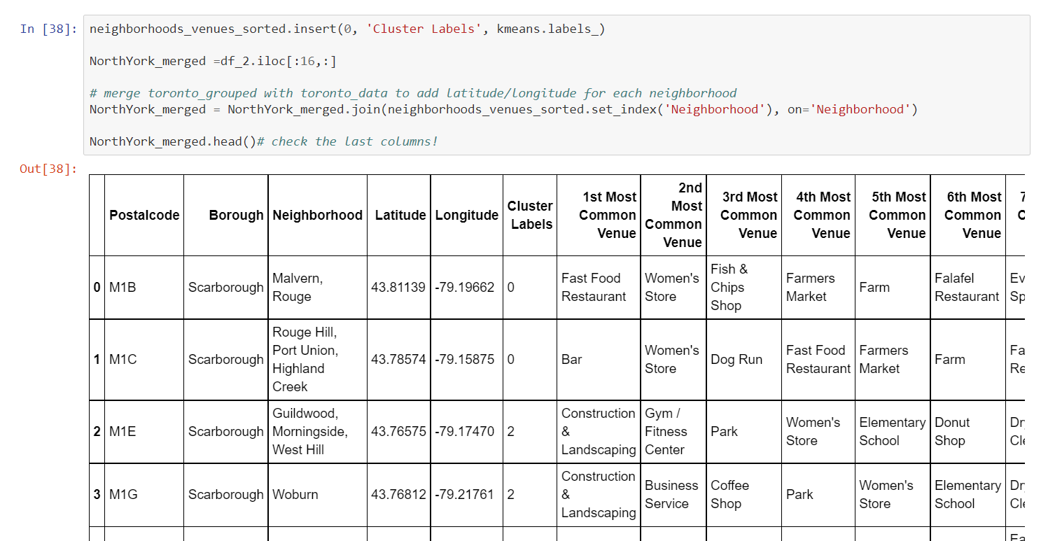
Using K-means Clustering Approach : Most Common Venue

Slide 8
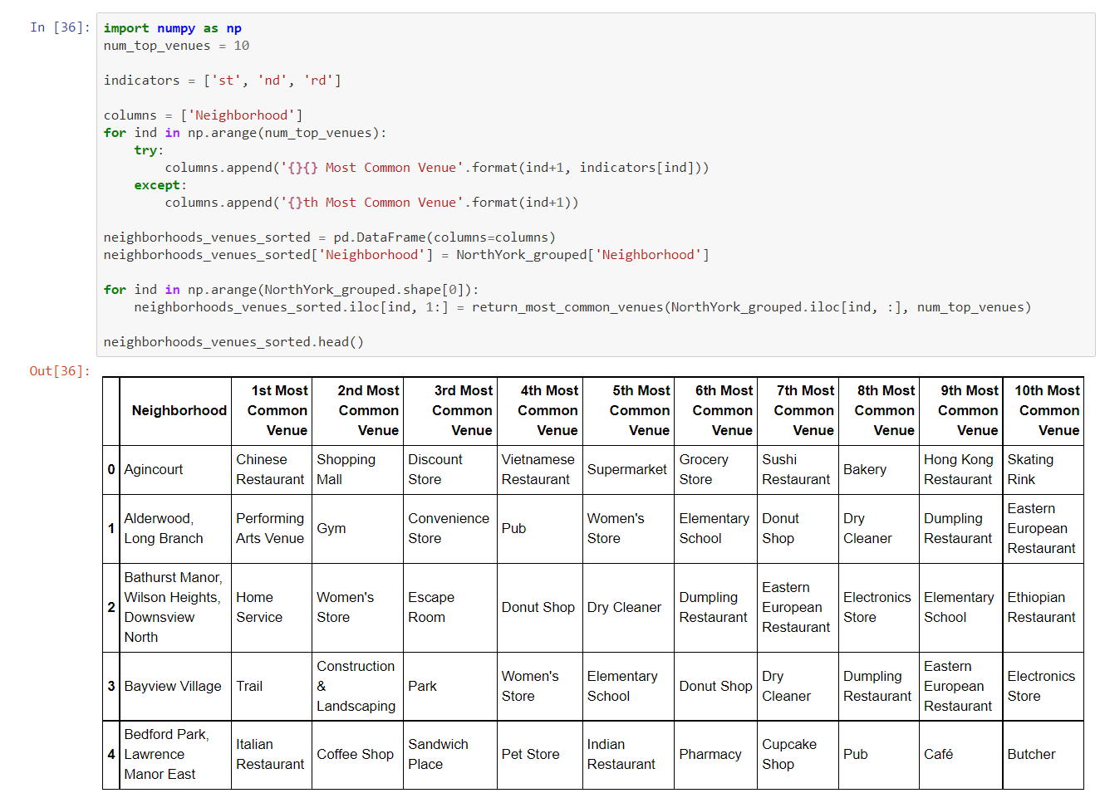
Most Common Venues near Neighbourhood: Using Clustering

Slide 9
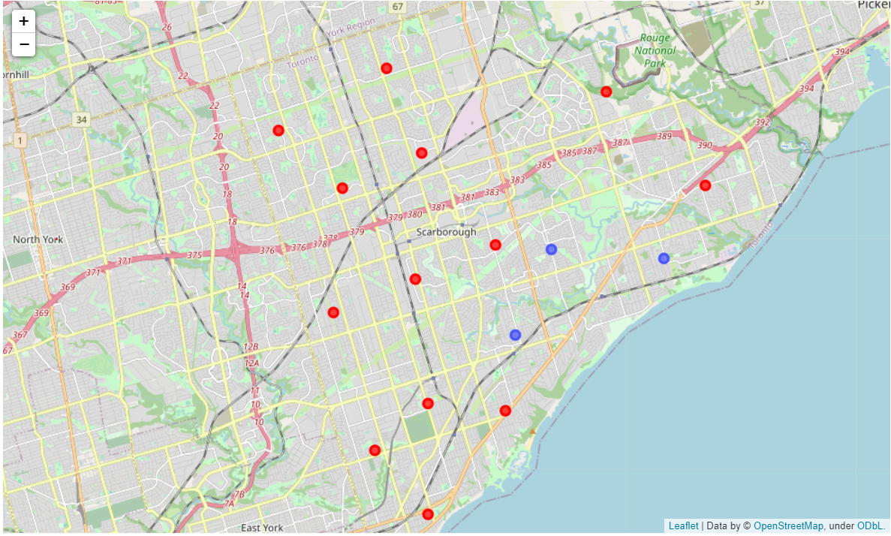
Result Section: Map of Clusters

Slide 10
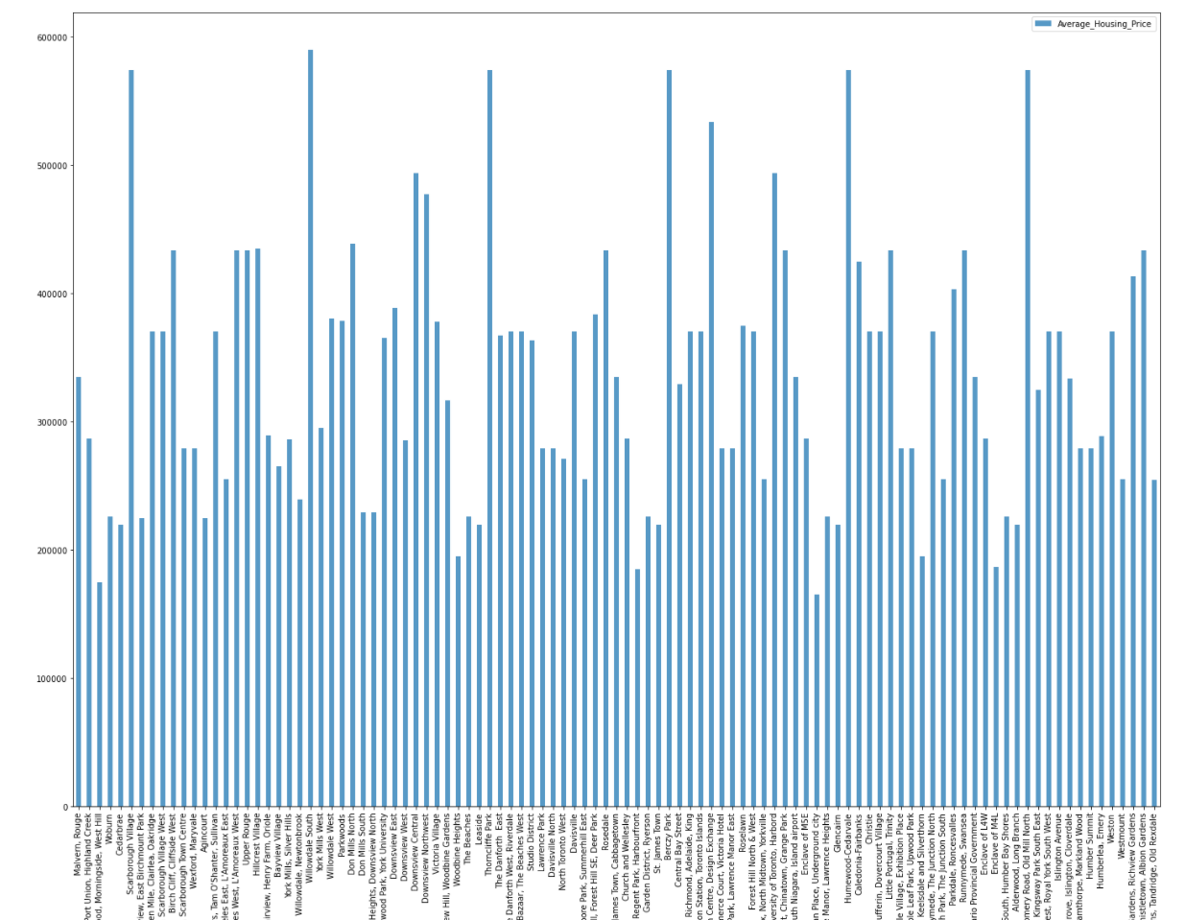
Average Housing Price

Slide 11
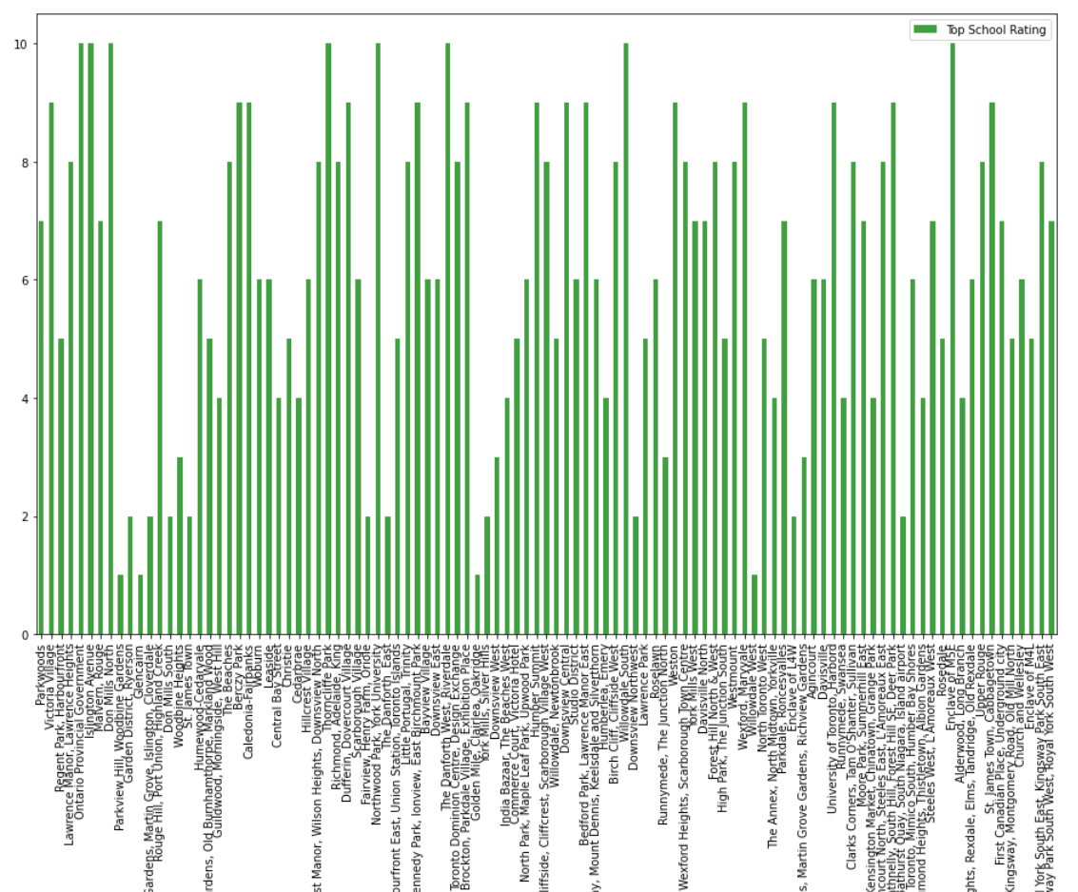
Average School Rating

